Slide 1
Digging In
Getting Familiar With The Code To Be A Better Tester
Hilary Weaver-Robb | @g33klady | github.com/g33klady

Slide 2

New slides, who dis?
Hilary Weaver-Robb
SQA Architect @ Quicken Loans - Detroit

Slide 3

Story Time!

Slide 4
Digging in to Digging In
Commits and PRs
Static Analysis & Code Coverage
Debug Tools
Other Tools

Slide 5
This is not about learning how to code.
This is learning about the code

Slide 6
Commits and PRs

Slide 7
Version control
Version control (or source control) is a system that records changes to a file or set of files over time so that you can recall specific versions later.
https://git-scm.com/book/en/v2/Getting-Started-About-Version-Control

Slide 8
Version control
Git
TFS
SVN
Bitbucket
CVS
Mercurial

Slide 9

Version control

Slide 10
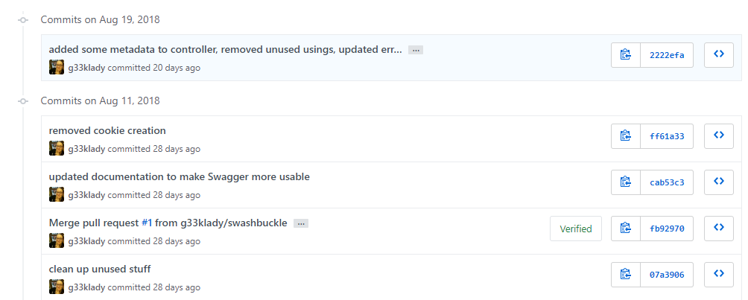
Commits

Slide 11
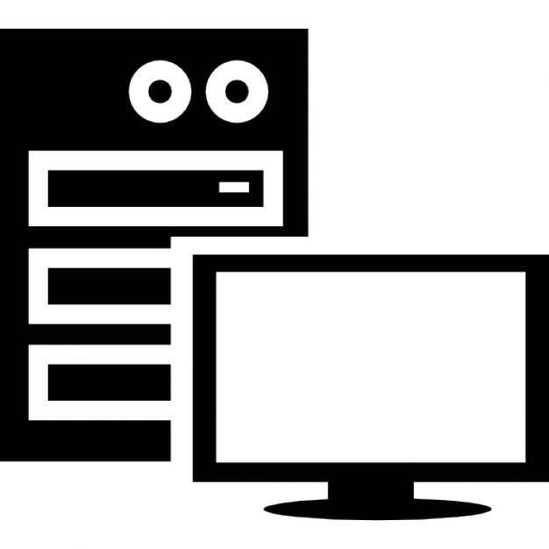

Pull Requests or PRs
master
fork
commits
PR

Slide 12
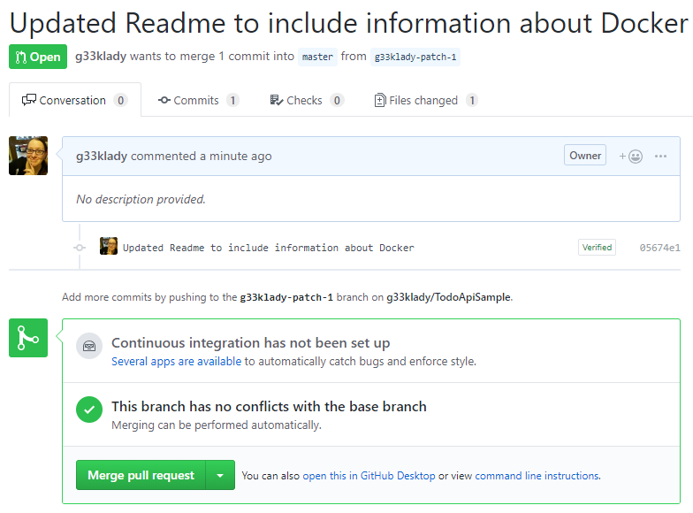
PRs

Slide 13
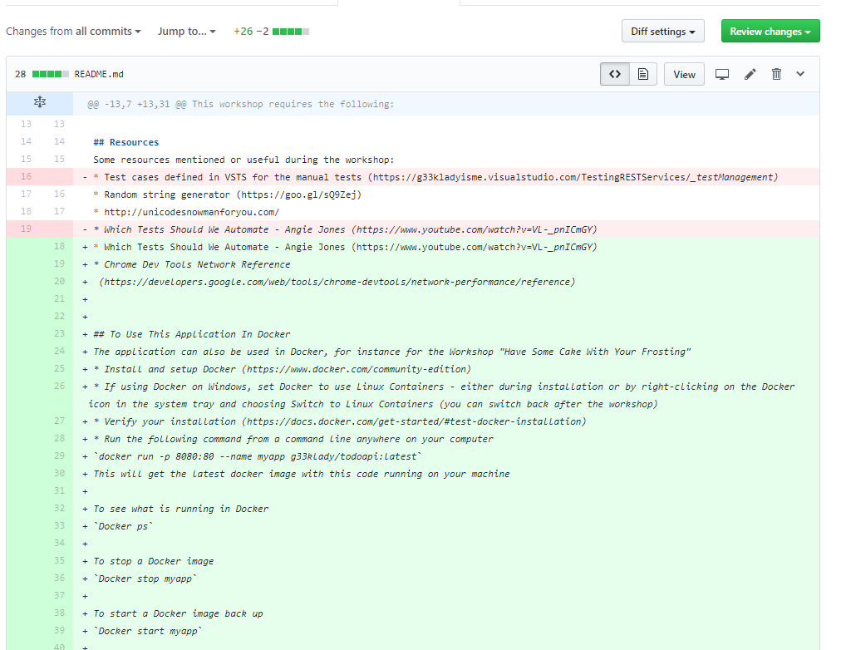
PRs

Slide 14
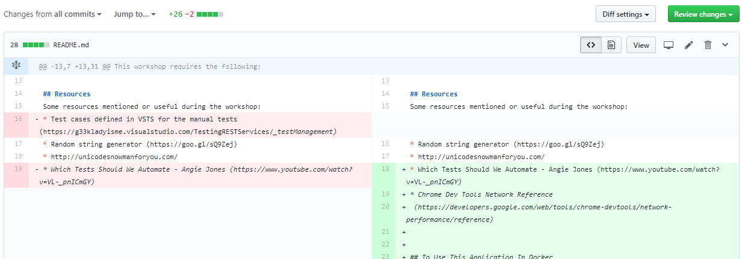
PRs

Slide 15
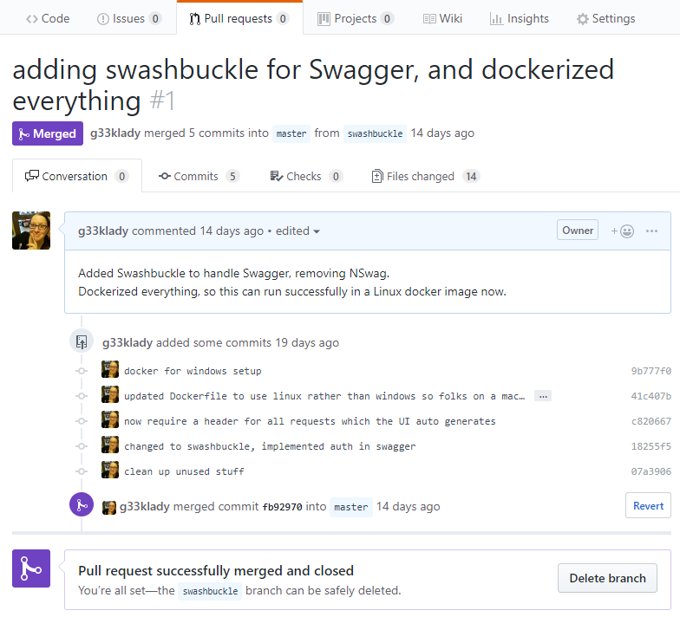
PRs

Slide 16
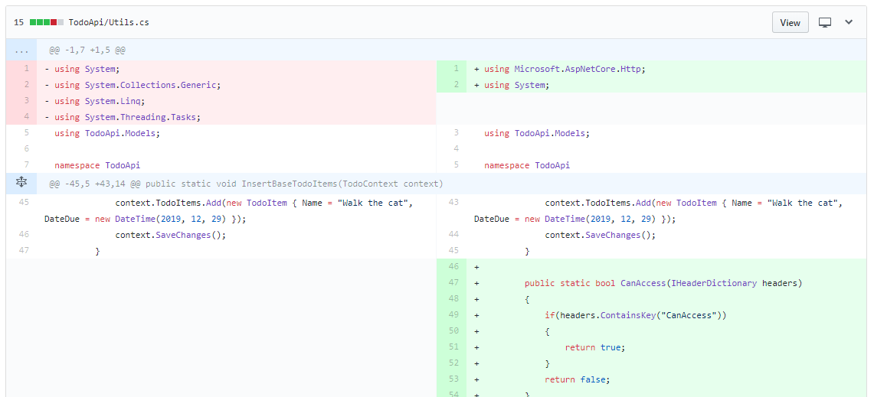
PRs

Slide 17
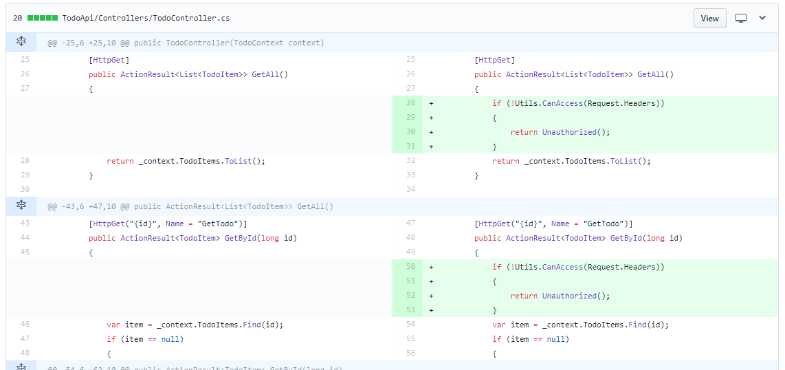
PRs

Slide 18
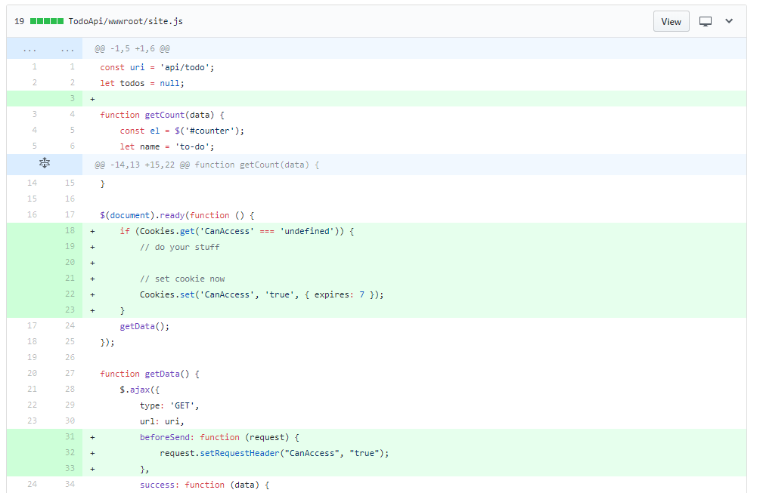
PRs

Slide 19
PRs

Slide 20
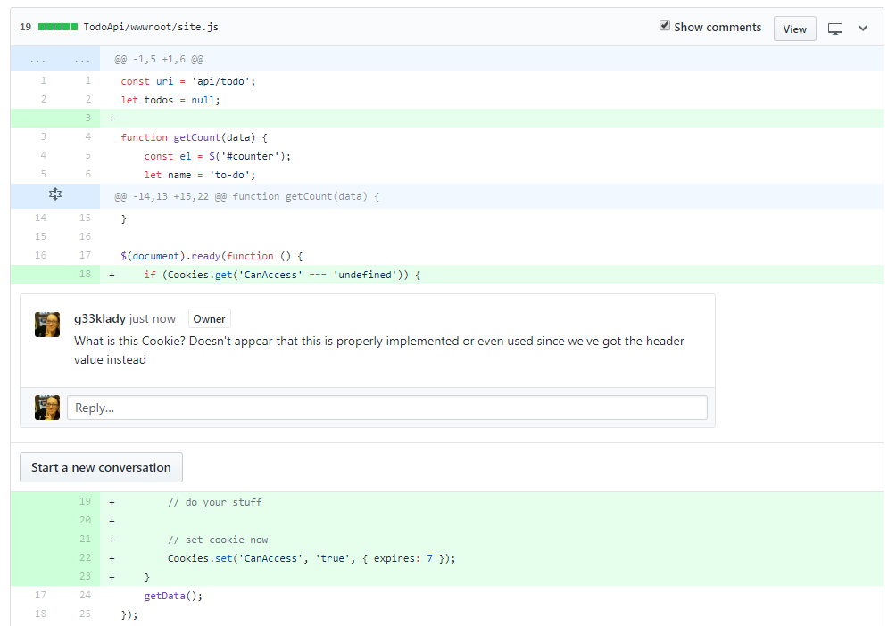
PRs

Slide 21
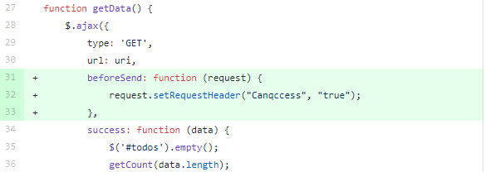
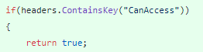
PRs

Slide 22



PRs
master
https://www.flickr.com/photos/fastjack/282707058/

Slide 23
PRs
master

Slide 24
Why care about commits and PRs?
Learn about & understand code changes firsthand
Get familiar with the codebase
Save time
Not about trust!

Slide 25
How to see commits and PRs?
Get any required permissions
Learn the VCS
Ask to be included in PR & code reviews
Tread carefully (if needed)

Slide 26
Static Analysis & Code Coverage

Slide 27
Static Analysis
Examining the code without executing it; providing understanding of code structure and ensuring the code adheres to industry standards
“It does not prove that your program is correct. It just provides another set of eyes to help spot problems.”

Slide 28
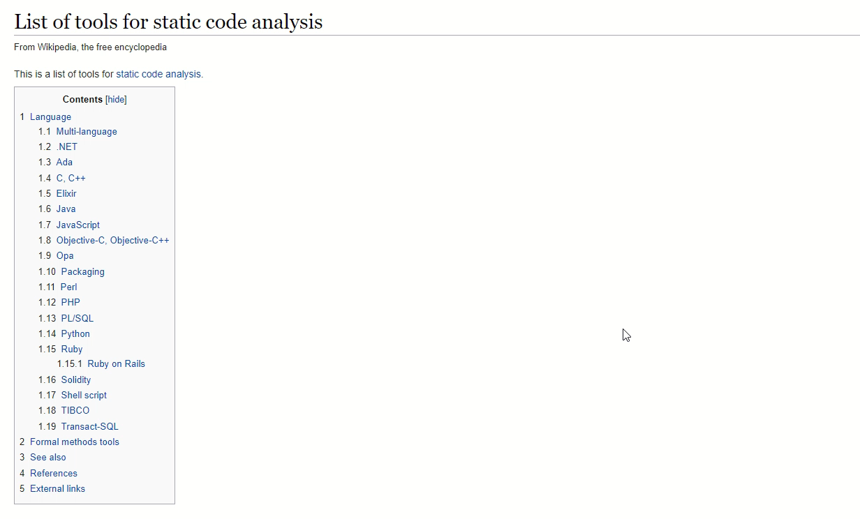

Slide 29
Types of Issues
Cosmetic
Code Smells
Bugs
Vulnerabilities

Slide 30
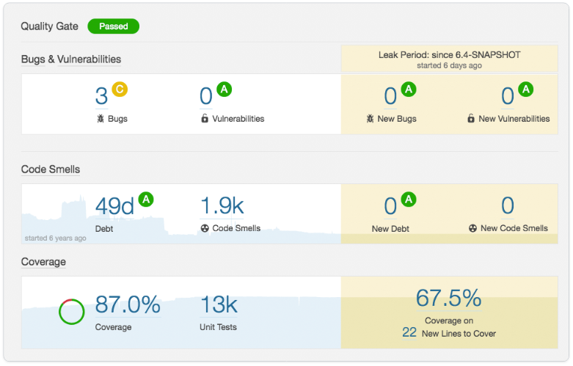
Static Analysis
https://docs.sonarqube.org

Slide 31
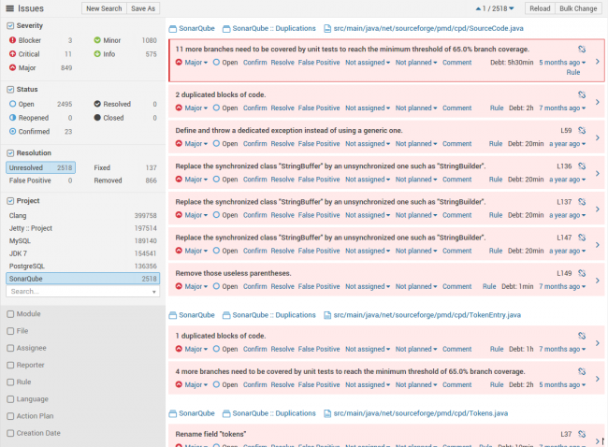
Static Analysis
https://docs.sonarqube.org

Slide 32
Why care about static analysis?
Learn about the “health” of the codebase
Visibility into bugs we may not see otherwise
Learn about security vulnerabilities

Slide 33
Code Coverage
Measure of how much of the code is executed when unit tests are run
Or
How much of the code is NOT unit tested
Not
How high quality the code is

Slide 34
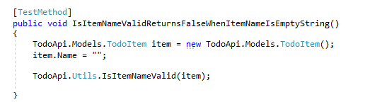
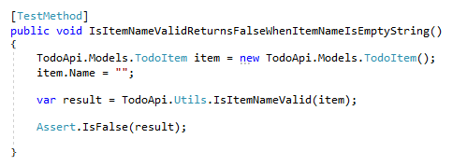

Slide 35
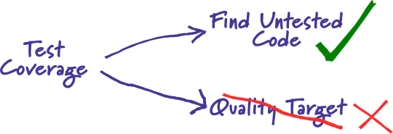
“Test coverage is a useful tool for finding untested parts of a codebase.
Test coverage is of little use as a numeric statement of how good your tests are.”
https://martinfowler.com/bliki/TestCoverage.html

Slide 36
Why care if it’s such a gamble?
Learn about dev behaviors
Learn what’s expected
Learn what’s in danger
Understand the state of the code when you get it

Slide 37
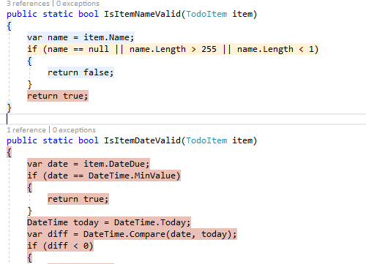

Slide 38
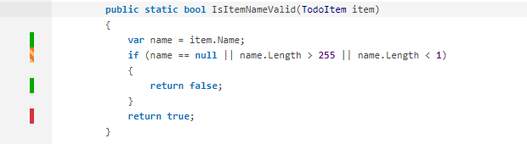

Slide 39
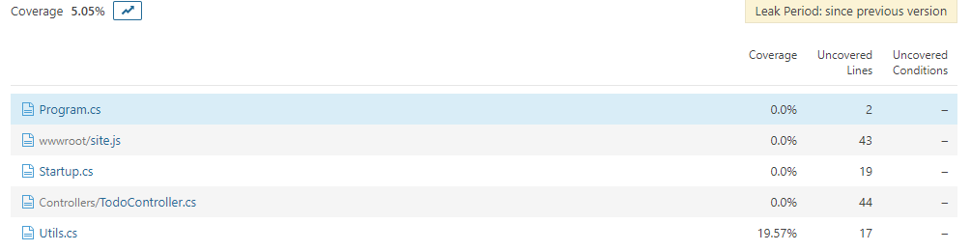

Slide 40


Empty String
Null
> 255 chars
> 1 and < 255
Numeric
Characters w/ diacritical marks
☃
“Special” characters

Slide 41
How to see static analysis and code coverage?
Find out what tools are in use & learn them
If no tools, advocate for them!
Go rogue!

Slide 42
Dev Tools

Slide 43
Dev tools
Suite of tools in modern browsers to assist with web development and testing
HTML, CSS, JavaScript
Network traffic
Performance
Cookies
Cache

Slide 44
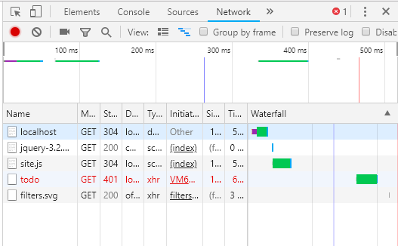

Slide 45
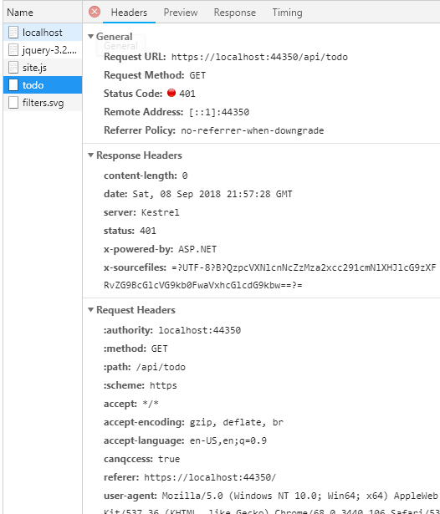

Slide 46
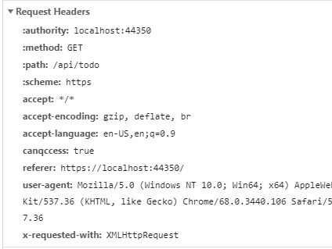

Slide 47
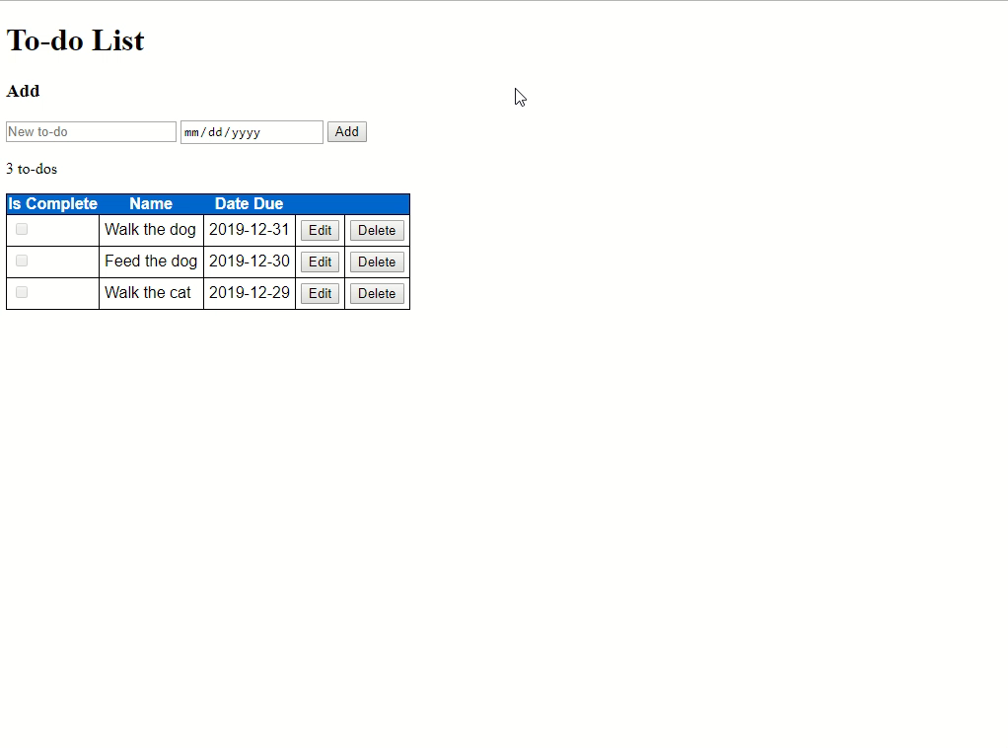

Slide 48
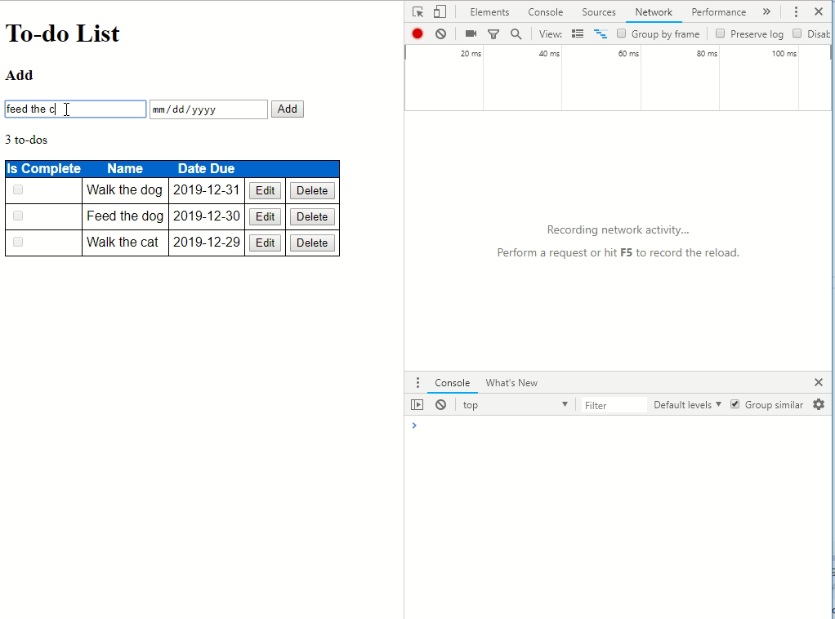

Slide 49
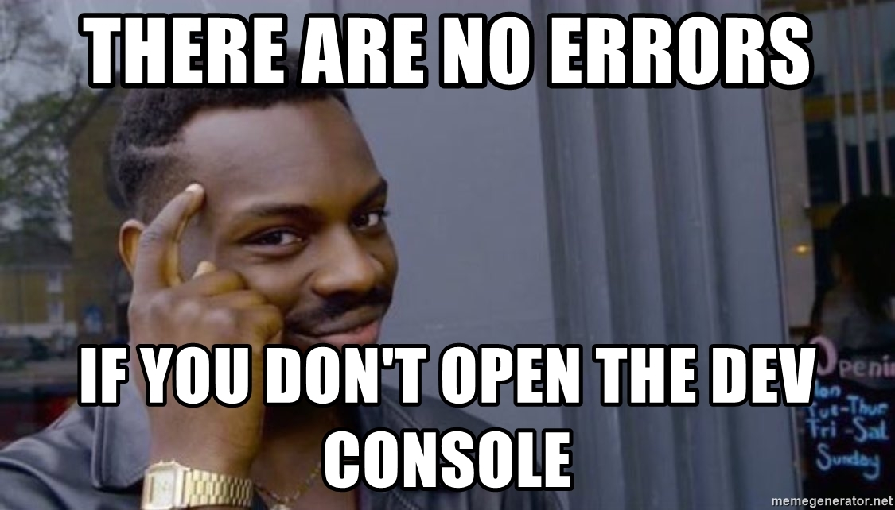

Slide 50
No browser? No problem!
Fiddler
Charles Proxy
Wireshark

Slide 51
Why use dev tools?
Peek under the surface
Wealth of information where you’re already testing!
Better understanding of the application

Slide 52
Other tools

Slide 53
Other tools to dig in
Logs
Monitoring tools
Support tickets
Other people!

Slide 54
So dig in!

Slide 55
Dig it!
Learn more about the code
Spot issues earlier in the dev cycle
Pinpoint vulnerable areas
Collect & use a ton of information

Slide 56

Questions?

